Slide 1

THREAT INTELLIGENCE IN A NUTSHELL:
FROM INTELLIGENCE TO EXPLOITATION
Abdel Sy Fane
Chicago CyberSecurity Meetup – President
Application Security Engineer - Allstate

Slide 2
WHAT IS THREAT-INTEL (TI)?
Collecting Information on your adversaries (Threat-Actors)
Defining who they are and what they’re capable of (Threat Modeling)
Hacktivist, APT Groups, Nation States, Hackers (driven by money or chaos)
Curating the Data (there’s tons of data out there!)
Contextualize & Visualize Threat Actors
Security Intelligence Tools (Gather & Analyze Threats)
Notes:
-TI is collecting information on your adversaries, who are your threat actors. With threat modeling, you are able to determine what your assets which if not all, is more important and how you’re going protect it from your threat actors.
-This gives you the strategic advantage to get ahead of emerging threats.
-Depending on who your organization is and what you’re trying to protect, you may have more than just one Threat Actor
-It then becomes important to now curate all of the threats you’ve collected because in 2017, research shown that there was a new strain of malware every 4.2 seconds which means you will potentially have millions of data that may not even be relevant to what you’re trying to protect
-Without the ability to contextualize and visualize your threat actors, you are simply collecting only threat data without any intelligence, hence the threats you’ve been collecting is useless and is not actionable data.
-In my own words, threat intelligence is actionable data you can act on to prevent or eradicate threats by giving you the strategic advantage of getting ahead of bad actors.

Slide 3
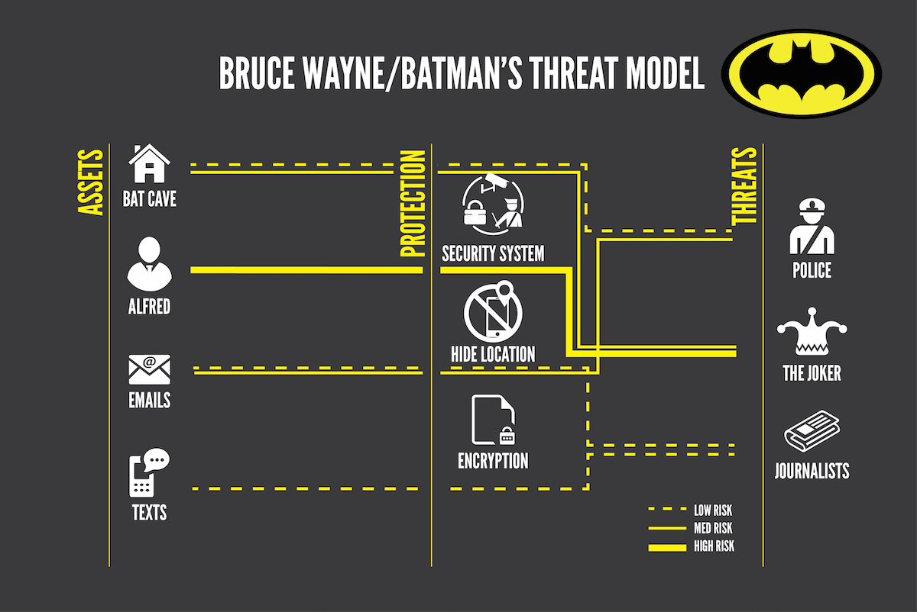
WHAT IS THREAT MODELING & WHY IS IT IMPORTANT?

Slide 4
MODELING FOR INTELLIGENCE
Know Your Organization
What is your organization’s role in the industry?
Know Your Infrastructure
What assets do you need to protect?
Know Your Actors
Which bad actor is most likely to come after your assets?
Know Your Tools
How are you going to gather threat data & analyze it?

Slide 5
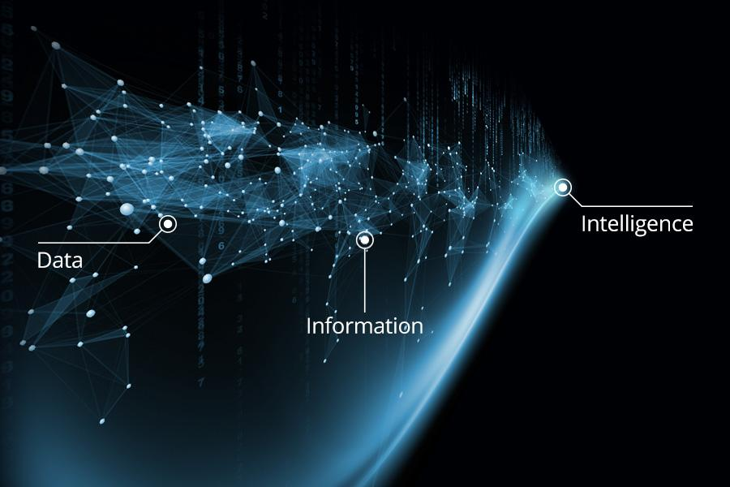
WHAT IS THREAT DATA, INFORMATION & INTELLIGENCE?
Unusual Network Traffic
Log-In Red Flags
Geographical Irregularities
Web Traffic with Unhuman Behavior
Anomalies in Privileged User Account Activity
Other Indicators of Compromise (IOCs)
Notes:
Threat Data becomes intel when you can correlate the data with other data to tell a story, a story that is used to make inform decisions.
Threat Data is unarguable data collected that states a fact
It is NOT intelligence
Threat Data is information overload with no context as to what is relevant to your organization. If you’re unable to prioritize then you are losing value of threate intel and waste your time looking at bad data
As you move towards intelligence, volume of data or noise decreases and value increases

Slide 6
THREAT INTEL, FEEDS & PLATFORMS
Threat Data Feeds
Pros:
Good starting point for Threat Intel (Threat Data is knowledge but not power)
Tons of OpenSource Feeds (FREE!)
Department of Homeland Security's (DHS) Enhanced Cybersecurity Services (ECS)
Knowledge shared among organizations and govt. entities (also FREE!)
Cons:
Data Feed alone cannot answer any vital questions regarding the threat
Data overload
Relevant intel can only be extracted by human (time consuming)
Notes:
This data on its own cannot answer vital questions: Are indicators connected to attacks on particular industries or technologies? What part do they play in a malicious infrastructure? Are they related to a specific type of malware? The only way to get this kind of vital context and actually generate relevant intelligence is to look for connections in the data, which in most cases is a very time-consuming and manual process.

Slide 7
THREAT INTEL, FEEDS & PLATFORMS (CONT.)
Human Intelligence (HUMINT)
Pros:
Collecting Threat Intelligence from human and machine sources
Rich in details and located in a searchable DB
Contextualized data prevalent to your organization
Cons:
Time:
Time consuming to collect data from multiple sources
Time consuming for human to analyze and correlate the data
Time consuming for human to connect the threat to your specific organization/industry

Slide 8
THREAT INTEL, FEEDS & PLATFORMS (CONT.)
Threat Intelligence Platforms
Pros:
Help organize threat data feeds (up to thousands of feeds)
Centralized feeds you’re subscribed to
Contextualize and visualize data and correlating/integrating to other security platforms, i.e. SIEMs
Prioritize what matters and setup alerts
Cons:
Configure threat data feeds
Only as good as the data coming in (feeds)
Can be costly

Slide 9
OPENSOURCE THREAT INTELLIGENCE
Write APIs to collect data from publicly available sources
Security News
Security Blogs
Security Forums
Security Researches
Social Media
Twitter – tinfoleak (Github)
Check out Awesome-Threat-Intelligence (Github)

Slide 10
NOTABLE OPEN SOURCE THREAT INTELLIGENCE RESOURCES
vFeed (Github)
MISP - Malware Information Sharing Platform and Threat Sharing (Github)
AlienVault - provides open access to a global community of threat researchers and security professionals

Slide 11
DEMO
Goals:
Find a vulnerability reported by vendor (CVE, CWE, CPE, OVAL, CAPEC, CVSS, WASC)
Find and correlate a vulnerability to a threat data
Use the threat intelligence to exploit the reported vulnerability

Slide 12
THANK YOU!
The Team: Abdel Sy Fane
Emily Stamm
Andrea Kim
Patrick O’Laughlin
Meetup.com/ChicagoSecurity

